Slide 1
Tapioca Dao
Analysts:
Daniel Raber, Kazu Umemoto
1/31/2023
What do you call tapioca that’s gone bad?
Notes:
Alex

Slide 2
Roadmap
1. Tapioca DAO Overview, Omnichain, Team
2. The Tokens
3. Yieldbox, Protocol Fees, Risks
4. Competitors
5. Valuation, Option Airdrop
6. Recommendation
Notes:
Daniel

Slide 3
What is Tapioca DAO?
Layer 0 DAO
First omnichain money market
Can be used across 12+ EVM chains
Looking to expand to non-EVM chains
Notes:
Kazu

Slide 4
Omnichain
Made by LayerZero
Omnichain interoperability protocol
Goal is to connect multiple L1 chains
Have similar tokens standards to the Ethereum
Notes:
Kazu

Slide 5
Team
Joshua-Jon Milko, CEO
Matthew Marino, COO
Nicole Mancuso, CIO
Notes:
Daniel

Slide 6
$TAP
LBP: 5% of supply in Q1 2023 for $3.52/coin
Staking available for twTAP
Inflation depending on oTAP Redemptions
Notes:
Daniel

Slide 7
$twTAP
ONFT721
Participate in governance and receive protocol revenue
Must lock up TAP to receive twTAP
Notes:
Kazu, what the revenue is paid out in

Slide 8
$oTAP
DAO Share Options
Lenders receive oTAP, call option incentives
American-style call option
Discount range between 0%-50%
Expires in one week after receiving
Notes:
Kazu

Slide 9
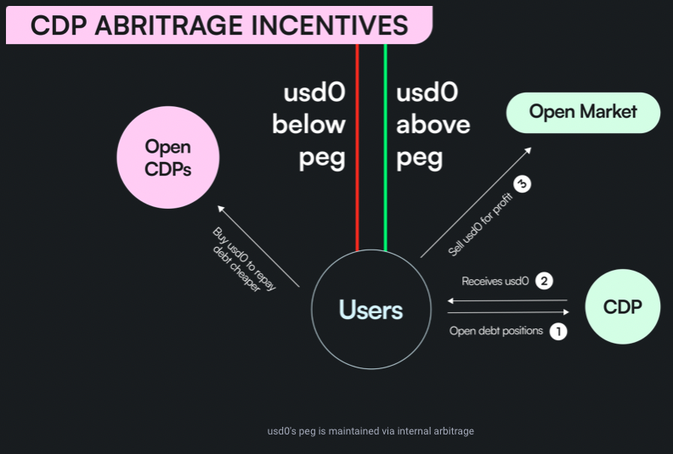
$usd0
Non-algorithmic
Overcollateralized
Soft Pegged to US Dollar
OFT20
Notes:
Daniel

Slide 10
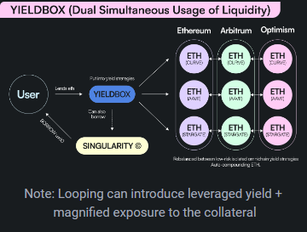
Yieldbox (Bentobox V2)
dApp support
Improvements over Bentobox
Idle funds invested in yield strategies
Notes:
Daniel – Github

Slide 11
Protocol Fees
Borrow Fee: 0.5%
Interest: ~0.5%
Liquidation Fee: 10%
Performance Fee: 15%
Flashmint: 0.001%
Notes:
Kazu

Slide 12
Risk
Limited TAP Supply
Smart Contract Exploitation
New Incentive Program
Notes:
Kazu

Slide 13
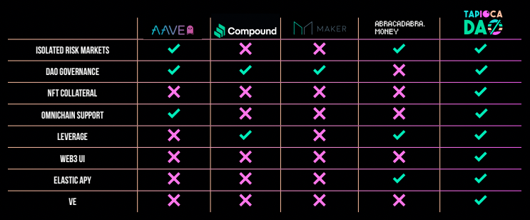
Competition
Notes:
Kazu

Slide 14
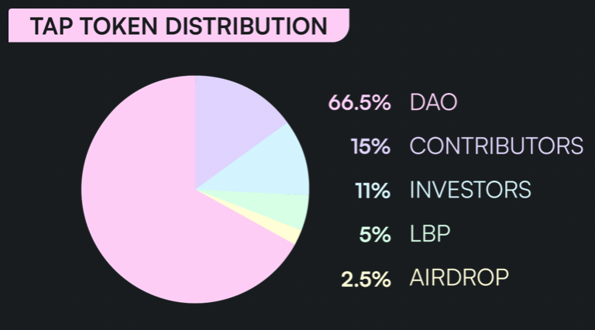
Valuation
Distribute 5M TAP tokens via LBP
Initial price of $3.52
Fully Diluted: $88M
Initial Investors are locked up to a certain extent
Notes:
Kazu

Slide 15
Option Airdrop
$3.52: 50%
$3.51-$3.00: 33%
$2.99-$2.50: 25%
$2.50-$2.00: 10%
Notes:
Kazu

Slide 16
Recommendation
$560
TAP
Notes:
Daniel

Slide 17
Questions?

