Slide 1
Change background color to match color scheme
Add company-specific logo on right (optional) or simply a contrasting color according to color scheme
Replace bottom left logo with either black or white (below) depending on background color, or use picture correction tools to change logo to whichever color matches your color scheme
May // 9 // 2023
ANALYST //
Kazu Umemoto
UNIVERSITY OF OREGON
INVESTMENT GROUP
UNIVERSITY OF OREGON
INVESTMENT GROUP

Slide 2
Insert new company-related background picture (use industry/process related images if no company-specific make sense)
Recolor image to make it basically black and white with slight color tint to match color scheme, then soften to 50% (all can be done in the “Picture Format” tab ribbon)
1
AGENDA
What is Hook
2
What are Call Options
3
Competitors
4
Recommendation
5
Questions

Slide 3
SECTION 1
What is Hook?
Hook
May 9, 2023
‹#›

Slide 4
What is Hook
EXAMPLE CHART
PRODUCT CATEGORY REVENUE MIX
NFT call option platform
Also operates similar to traditional NFT marketplace
10% fee on options sold through hook
‹#›
Notes:
10 fairly popular NFT projects, 4 of them are in our range, 2 are ones that I can actually get behind

Slide 5
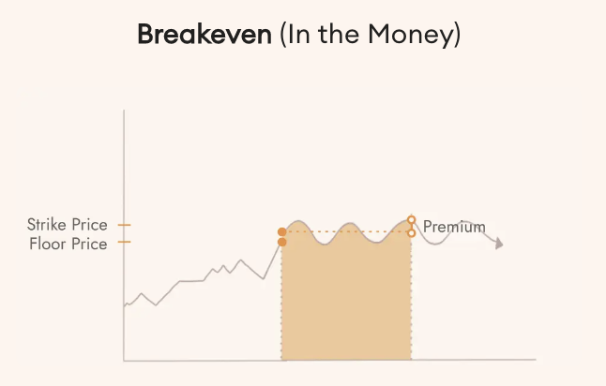
Add firm/thesis related image to left pane (optional) or add contrasting color according to color scheme
Replace chart with thesis related graphic
Color chevrons/fonts according to theme
Earn
One of Hook’s main products
Earn wETH
Can adjust the risk you want your NFTs to take and the compensation you would receive
‹#›
‹#›

Slide 6
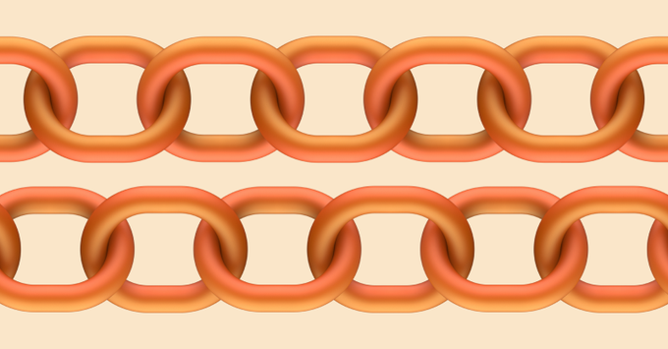
EXAMPLE CHART
Team
PRODUCT CATEGORY REVENUE MIX
Jake Nyquist
Regynald Augustin
‹#›

Slide 7
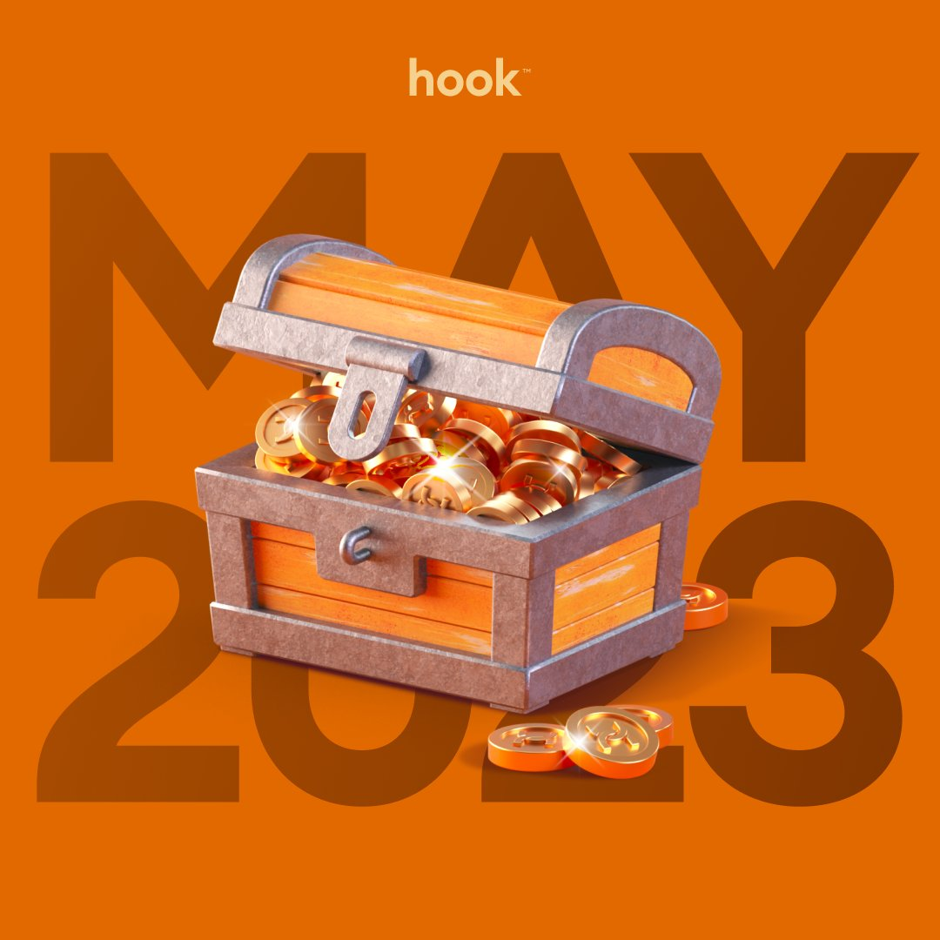
Add firm/thesis related image to left pane (optional) or add contrasting color according to color scheme
Replace chart with thesis related graphic
Color chevrons/fonts according to theme
Roadmap
No official roadmap
Potentially going to add put options in the future
Possible airdrop
‹#›
‹#›

Slide 8
SECTION 2
What are Call Options?
Hook
May 9, 2023
‹#›

Slide 9
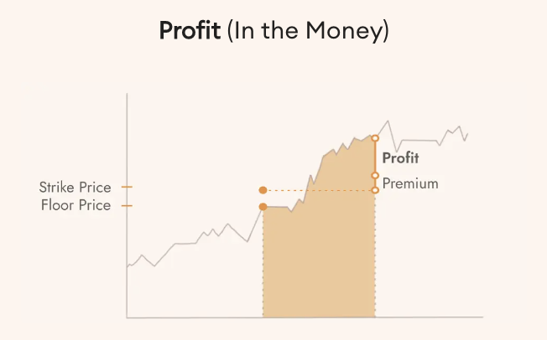
Add firm/thesis related image to left pane (optional) or add contrasting color according to color scheme
Replace chart with thesis related graphic
Color chevrons/fonts according to theme
What are call options?
European vs American
Financial contract that gives the buyer the right to buy an asset at a certain price
We would be selling long call options on the NFTs
‹#›

Slide 10
SECTION 3
Competitors
Hook
May 9, 2023
‹#›

Slide 11
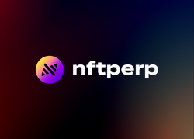
Add firm/thesis related image to left pane (optional) or add contrasting color according to color scheme
Replace chart with thesis related graphic
Color chevrons/fonts according to theme
Competitors
NFTperp is the only real main competitor
Gives price on whole collections instead of just individual NFTs
Uses an average sales price and “sensitivity multiplier” to determine the price of the collection
‹#›

Slide 12
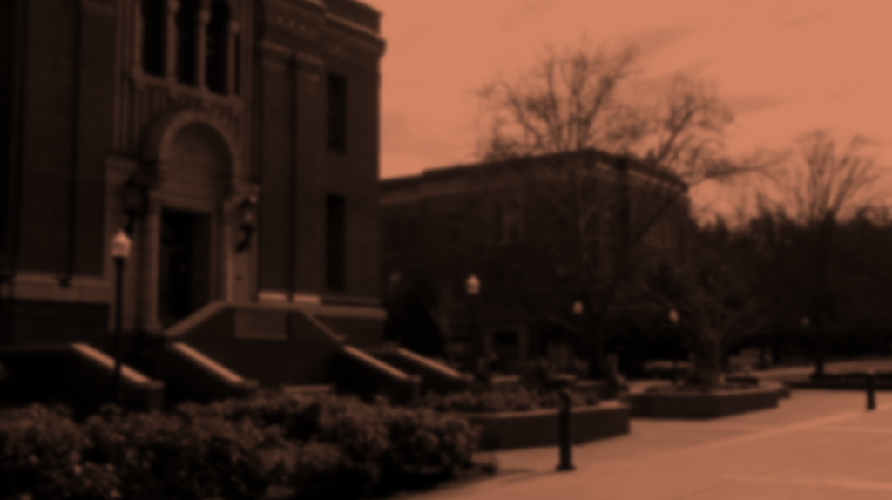
SECTION 4
Recommendation
Hook
May 9, 2023
‹#›

Slide 13
Add chart
Change font/shape colors & outlines according to color scheme
Lil Nouns & Oddities
Lil Nouns
Minted every 15 minutes
Vote on governance proposals
Adding ESG to portfolio
EXAMPLE CHART
REVENUE BY REPORTED SEGMENT
Oddities
Each Odditiy is derived from a Moonbird
Access to Proof discord
Potential alpha
‹#›

Slide 14
Add firm/thesis related image to left pane (optional) or add contrasting color according to color scheme
Replace chart with thesis related graphic
Color chevrons/fonts according to theme
Strategy
~ .55 ETH
Mint 2 Lil Nouns
Purchase 1 Moonbirds Oddites
Put them into Hook’s Earn product

Slide 15
SECTION 5
Questions?
Hook
May 9, 2023
‹#›

